Slide 1
Welcome to
Total Quality Management
(19MEE347)
Unit 3 – 5S
Name: Dr. Sunil Kumar
Department of Mechanical Engineering

Slide 2
What is 5S - Overview
5S is a workplace organization methodology that uses a list of five Japanese words which are Seiri, Seiton, Seiso, Seiketsu and Shitsuke.

Slide 3
Translated into English
Sorting (seiri)
Straightening (seiton)
Systematic cleaning (seiso)
Standardizing (seiketsu)
Sustaining (shitsuke)

Slide 4
Sorting (Seiri)
Eliminate all unnecessary tools, parts, and instructions.
Keep only essential items and eliminate what is not required
Prioritizing things per requirements and keeping them in easily-accessible places.
Everything else is stored or discarded.

Slide 5
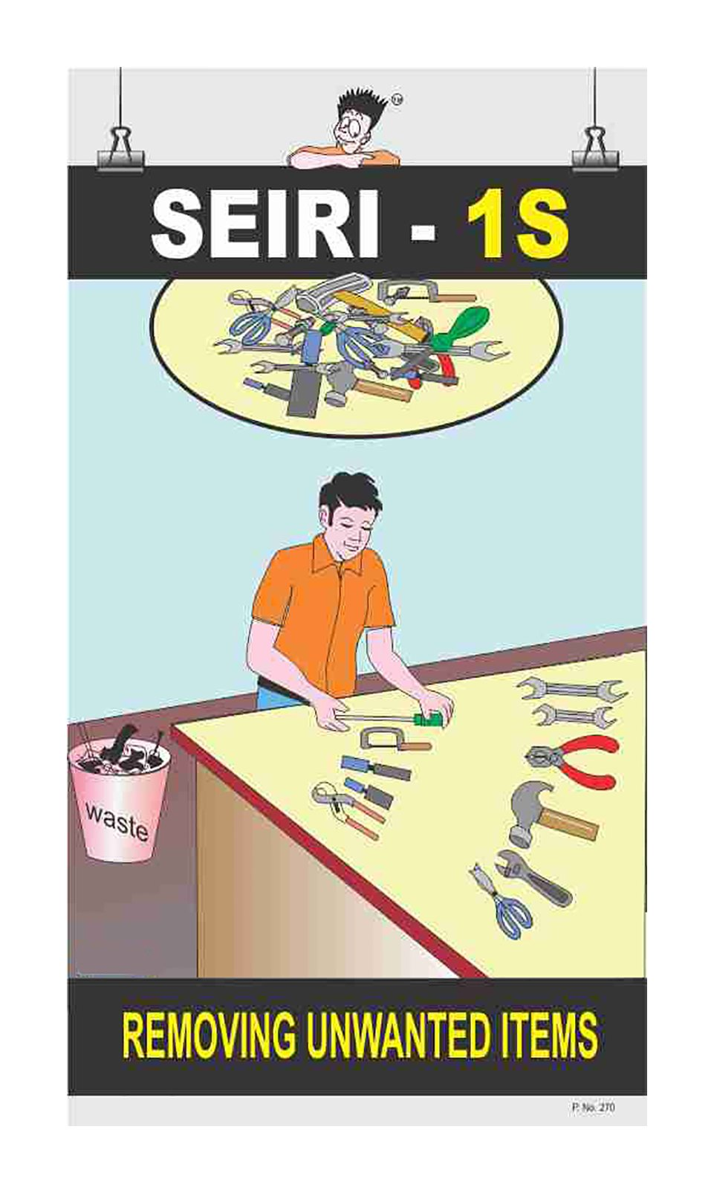
Sorting (Seiri)

Slide 6
Setting in order / stabilize (Seiton)
There should be a place for everything and everything should be in its place.
The place for each item should be clearly labelled
Items should be arranged in a manner that promotes efficient work flow, with equipment used most often being the most easily accessible.

Slide 7
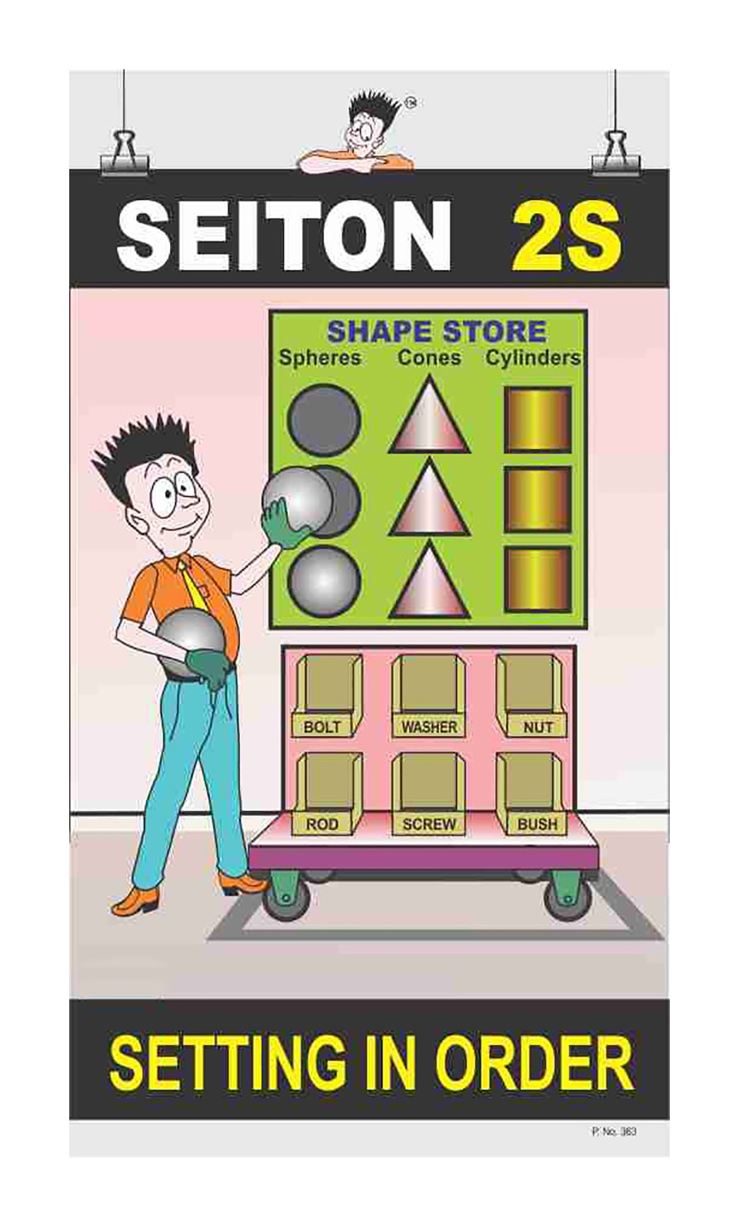
Setting in order / stabilize (Seiton)

Slide 8
Shining or systematic cleaning (Seiso)
Clean the workspace and all equipment, and keep it clean, tidy and organized.
At the end of each shift, clean the work area and be sure everything is restored to its place.
Maintaining cleanliness should be part of the daily work – not an occasional activity initiated when things get too messy.

Slide 9
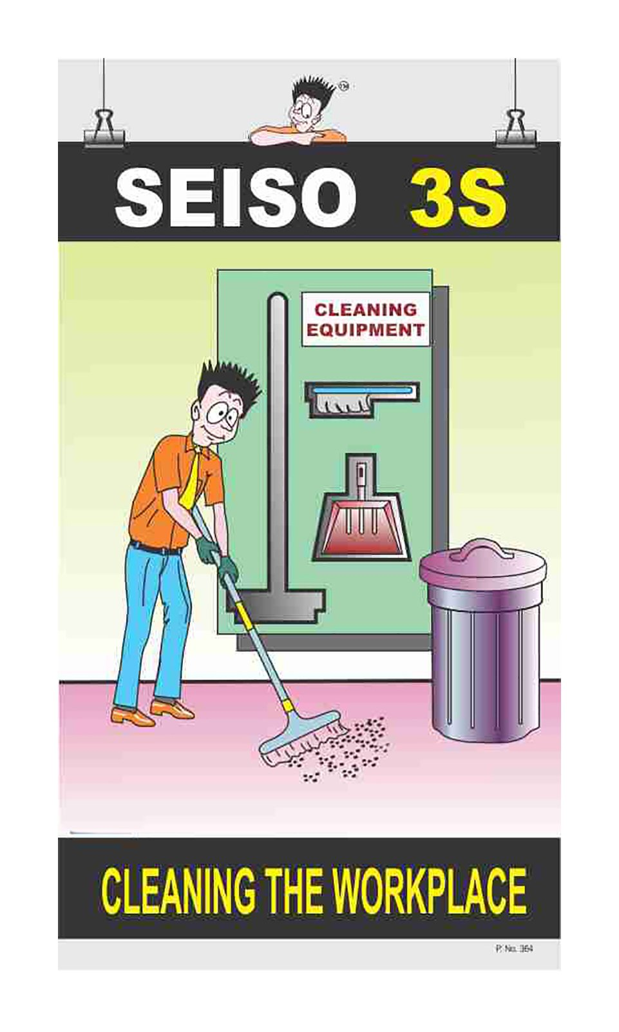
Shining or systematic cleaning (Seiso)

Slide 10
Standardizing (Seiketsu)
All work stations for a particular job should be identical.
All employees doing the same job should be able to work in any station with the same tools that are in the same location in every station.
Everyone should know exactly what his or her responsibilities are for adhering to the first 3 S's.

Slide 11
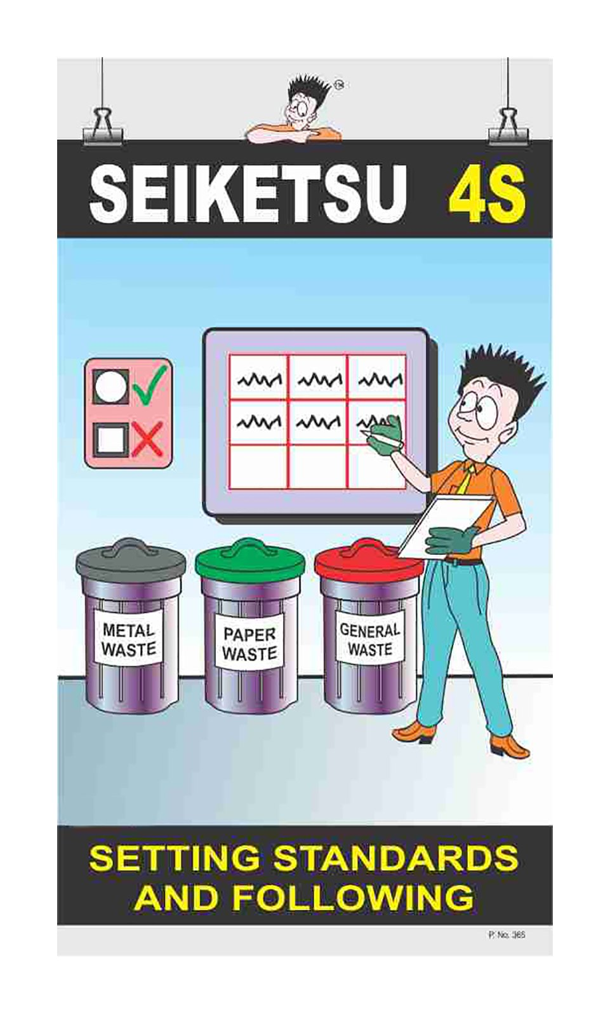
Standardizing (Seiketsu)

Slide 12
Sustaining the discipline or self-discipline (Shitsuke)
Maintain and review standards.
Maintain focus on this new way and do not allow a gradual decline back to the old ways.
While thinking about the new way, also be thinking about yet better ways.

Slide 13
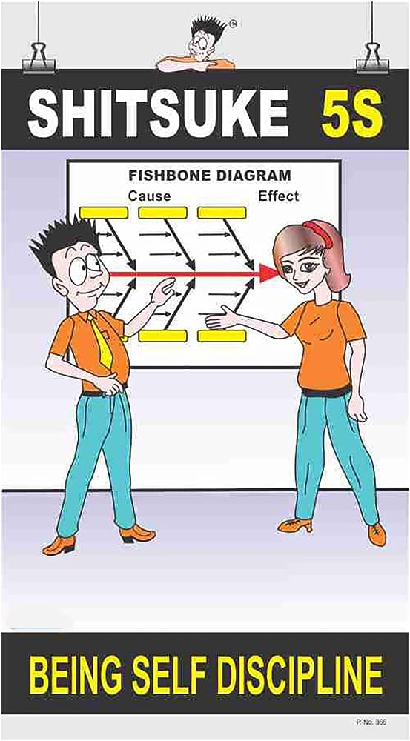
Sustaining the discipline or self-discipline (Shitsuke)

Slide 14
BENEFITS OF 5S
Improves organizational efficiency
Reduces waste in all forms
Cuts down employee frustration when "the system doesn’t work"
Improves speed and quality of work performance
Improves safety
Creates a visually attractive environment
Reduce direct and hidden costs
Enhances employee motivation

Slide 15
OBJECTIVES OF 5S
Productivity
Safety
Reduced Waste
Worker Commitment

Slide 16
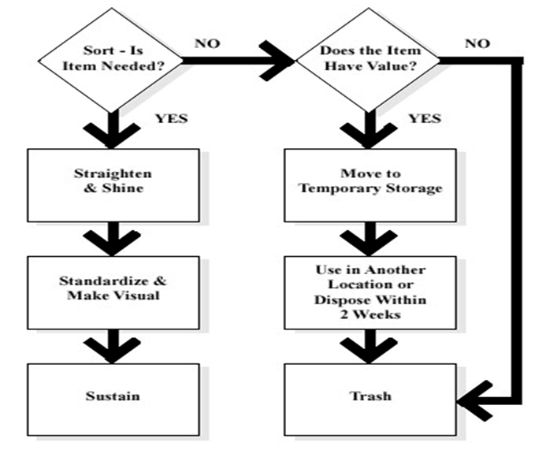
5S Flowchart

Slide 17
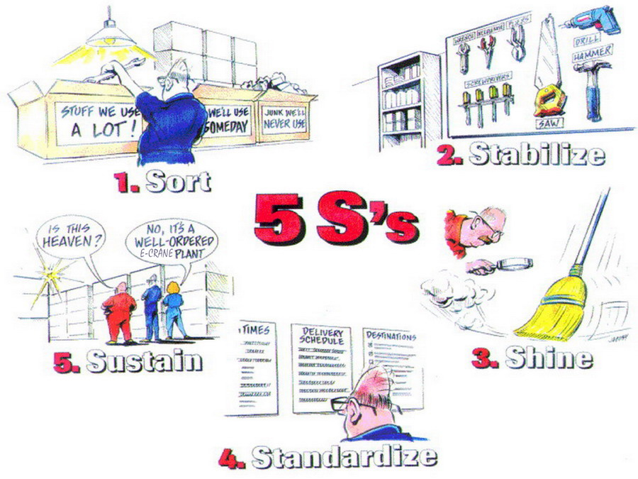

Slide 18
THANK YOU!!!

